Slide 1

Data 607 Final Project: Apartment Rental Cost Changes Over Time
Leticia Salazar
Fall 2021

Slide 2
Introduction
Rental prices have increased since 1980
Average of 8.86% per year
Nationwide average monthly rent is $1,164
Within the 21st century the median rent increases annual rate of 4.17%
How does this compare by state, particularly in New York?
Did the pandemic have a big effect on rental prices?

Slide 3
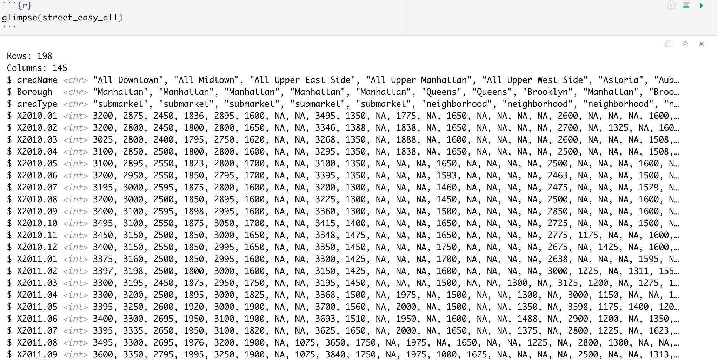
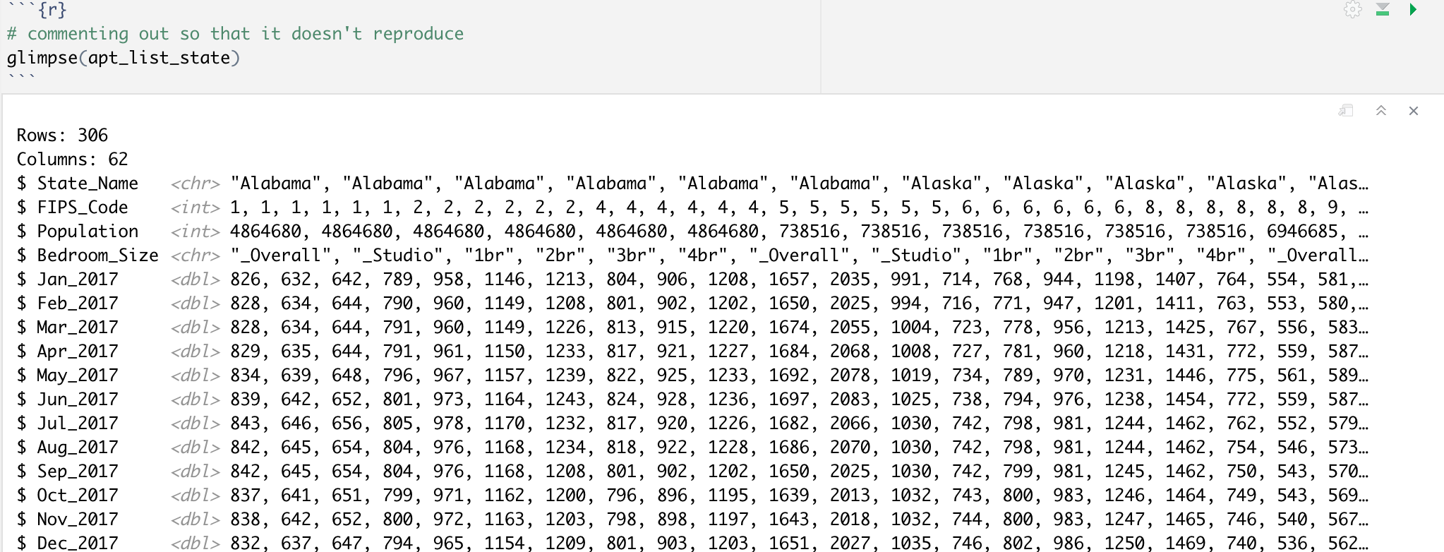
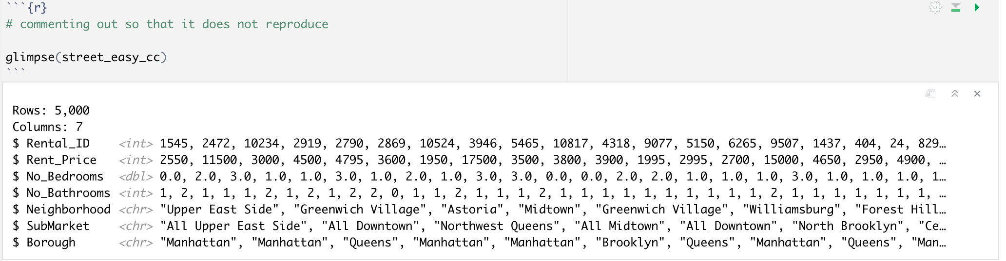
Data:
StreetEasy Dashboard
Apartment List Dashboard
GitHub Codecademy + StreetEasy

Slide 4
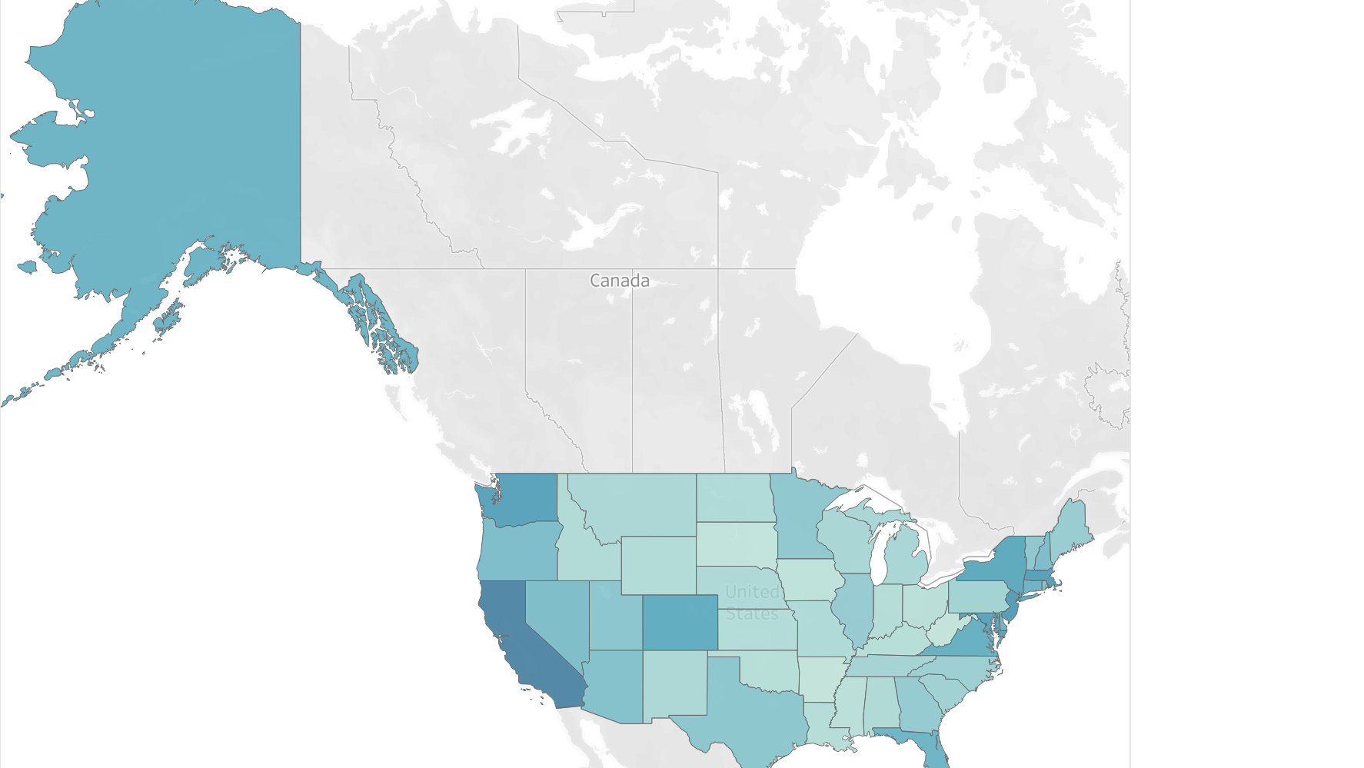
Tableau Public Graphs

Slide 5
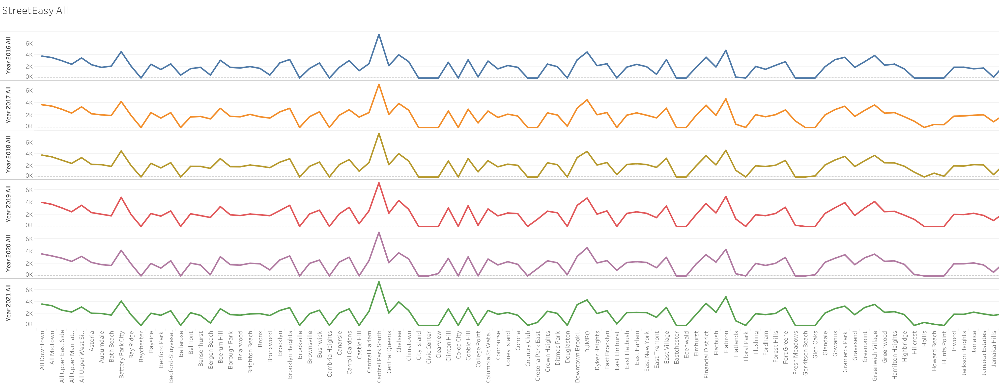
StreetEasy All Rent Price by Area Name

Slide 6
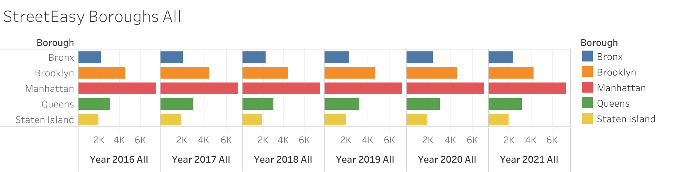
Boroughs by Years in All Apartment Types

Slide 7
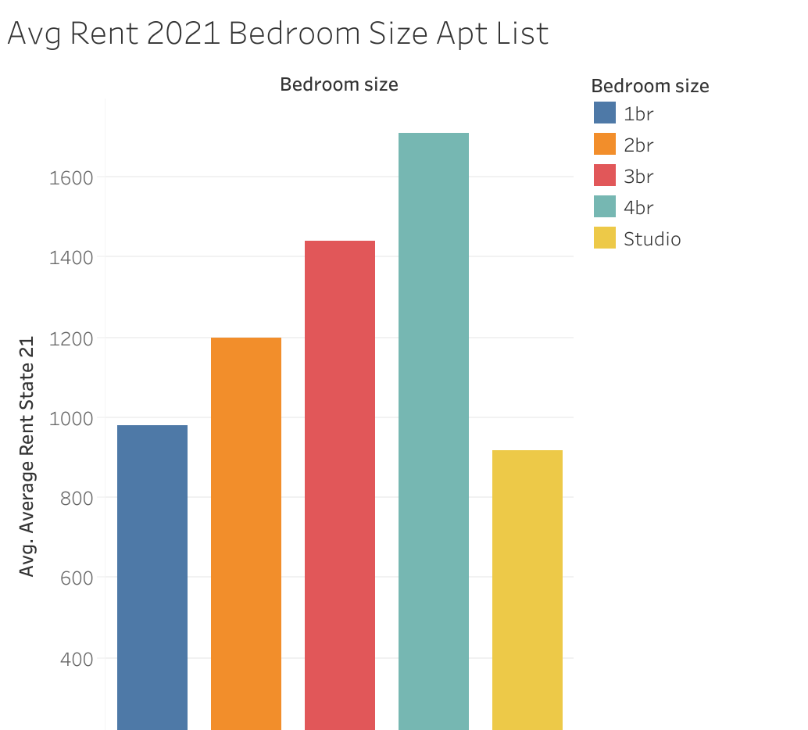


Apartment List Data

Slide 8
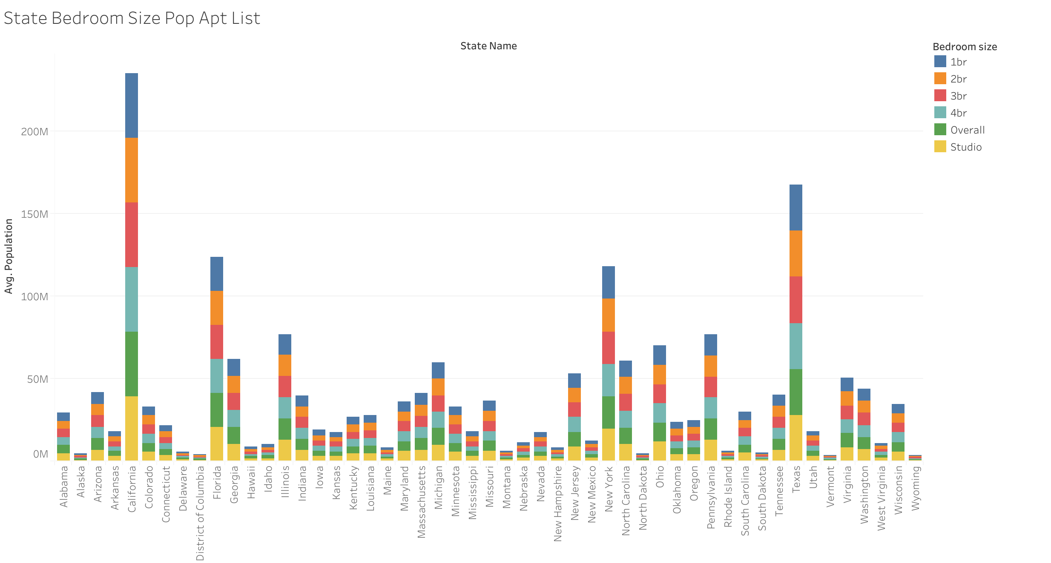
Population Size by State and Bedroom Size

Slide 9
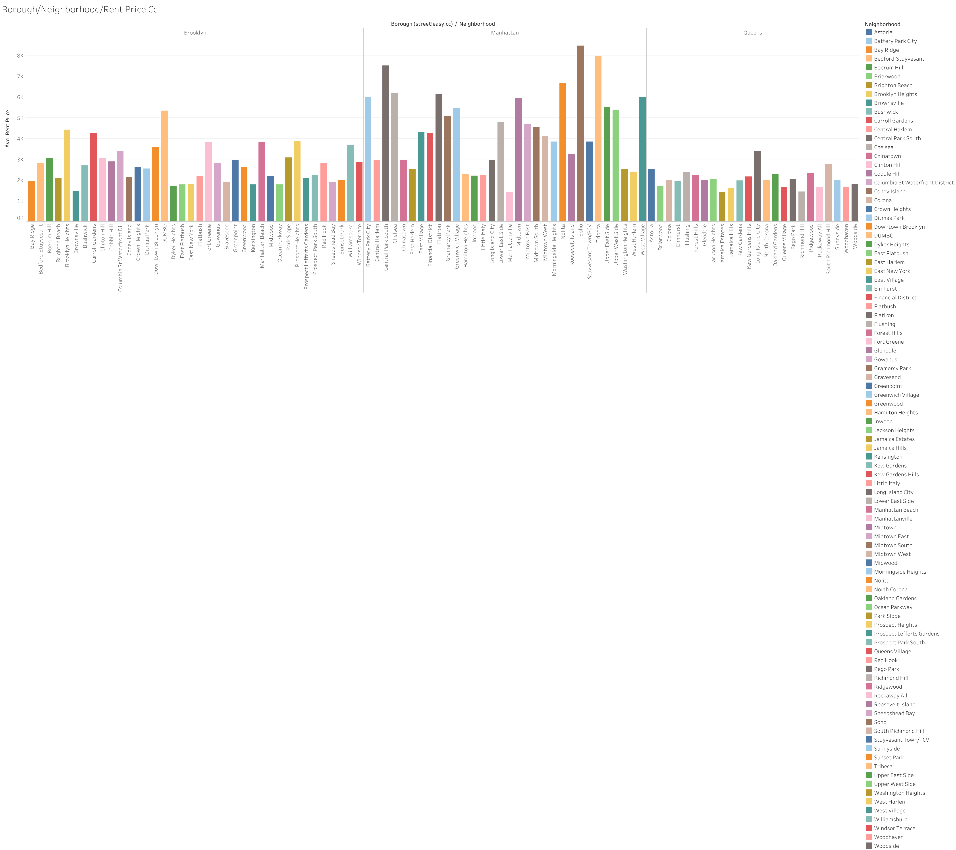
Codecademy + StreetEasy Data

Slide 10
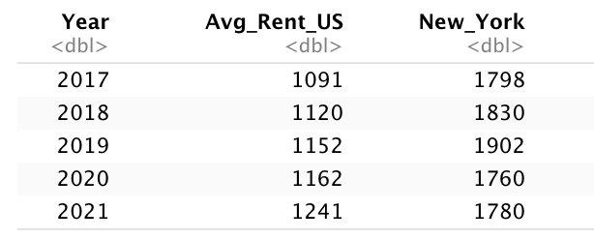
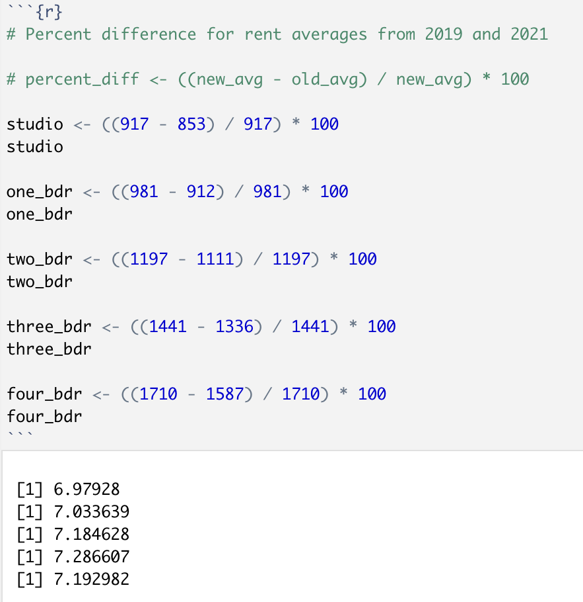
Conclusion
How does this compare by state, particularly in New York?
Looking deeper into NY, it has a higher rent average from the years 2017 – 2021
Within the top 3 Boroughs, these were the highest average rent prices within their neighborhoods:
* Brooklyn
* Dumbo
* Brooklyn Heights
* Carroll Gardens
* Prospect Heights
* Fort Greene
* Manhattan
* Soho
* Tribeca
* Central Park South
* Nolita
* Chelsea
* Queens
*Long Island City
* South Richmond Hill
* Astoria
* Flushing
* Ridgewood

Slide 11
Conclusion
Did the pandemic have a big effect on these rental cost prices?
The pandemic has affected rent prices all throughout the United States. Although the most expensive states saw rent price drops between 2020 and 2021, there have been increases in average rent as well in the US. New York has one of the highest average in rent prices compared to the United States overall. Not only that but based on these numbers I predict that apartment rental prices will continue to rise an average of about 7% within the next two years.

Slide 12
Assumptions and Challenges
A big challenge for me was the timeline I should consider, if 2018 - 2021 would suffice.
I would see a larger decrease in rent for 2020 and into 2021
One assumption that was true was Manhattan having the highest average rent price in NYC.

Slide 13
References
Streeteasy Data Dashboard: StreetEasy. StreetEasy Blog. (2019, November 20). Retrieved November 14, 2021, from https://streeteasy.com/blog/data-dashboard/.
Salviati, C., Popov, I., Warnock, R., & Szini, L. (2021, November 30). Apartment List National Rent Report. Apartment List - More than 5 Million Apartments for Rent. Retrieved November 14, 2021, from https://www.apartmentlist.com/research/national-rent-data.
Last Updated: October 26. (2021, October 26). Average rent by year [1940-2021]: Historical rental rates. iPropertyManagement.com. Retrieved November 14, 2021, from https://ipropertymanagement.com/research/average-rent-by-year.
Statista Research Department. (2021, August 25). Topic: Rental market in the U.S. Statista. Retrieved November 14, 2021, from https://www.statista.com/topics/4465/rental-market-in-the-us/#dossierKeyfigures.
https://github.com/Codecademy/datasets/tree/master/streeteasy

